Slide 1

Presentation on
“Flight Price Prediction”
Presented By: Ravi Kumar Sharma

Slide 2
Agenda
Introduction
Problem Statement
Problem Understanding
Benefits of Flight Price Prediction
Data Analysis & Model Building Flowchart
Exploratory Data Analysis Steps
Visualizations: Univariate and Bivariate
Data Analysis Steps Done
Assumptions
Model Building
Hyper Parameter Tuning and Crating Final Model
Saving the model and prediction results
Conclusion

Slide 3

Introduction
Airline industry is one of the most sophisticated in its use of dynamic pricing strategies to maximize revenue, based on proprietary algorithms and hidden variables. That is why the airline companies use complex algorithms to calculate the flight ticket prices.
There are several different factors on which the price of the flight ticket depends. The seller has information about all the factors, but buyers are able to access limited information only which is not enough to predict the airfare prices. Considering the features such as departure time, arrival time and time of the day it will give the best time to buy the ticket.
Nowadays, the number of people using flights has increased significantly. It is difficult for airlines to maintain prices since prices change dynamically due to different conditions. That’s why we will try to use machine learning models to solve this problem. This can help airlines by predicting what prices they can maintain. It can also help customers to predict future flight prices and plan their journey accordingly.

Slide 4

Problem Statement
Anyone who has booked a flight ticket knows how unexpectedly the prices vary. The cheapest available ticket on a given flight gets more and less expensive over time. This usually happens as an attempt to maximize revenue based on -
1. Time of purchase patterns (making sure last-minute purchases are expensive).
2. Keeping the flight as full as they want it (raising prices on a flight which is filling up in order to reduce sales and hold back inventory for those expensive last-minute expensive purchases).
Business goal: The main aim of this project is to predict the price of flight tickets based on various features. The purpose of the paper is to study the factors which influence the fluctuations in the airfare prices and how they are related to the change in the prices.
Then using this information, build a system that can help buyers whether to buy a ticket or not. So, we will deploy an Machine Learning model for flight ticket price prediction and analysis. This model will provide the approximate selling price for the flight tickets based on different features.

Slide 5

Problem Understanding
Airlines implement dynamic pricing for their tickets, and base their pricing decisions on demand estimation models. The reason for such a complicated system is that each flight only has a set number of seats to sell, so airlines have to regulate demand. In the case where demand is expected to exceed capacity, the airline may increase prices, to decrease the rate at which seats fill. On the other hand, a seat that goes unsold represents a loss of revenue, and selling that seat for any price above the service cost for a single passenger would have been a more preferable scenario.
Here we are trying to help the buyers to understand the price of the flight tickets by deploying machine learning models. These models would help the sellers/buyers to understand the flight ticket prices in market and accordingly they would be able to book their tickets.

Slide 6
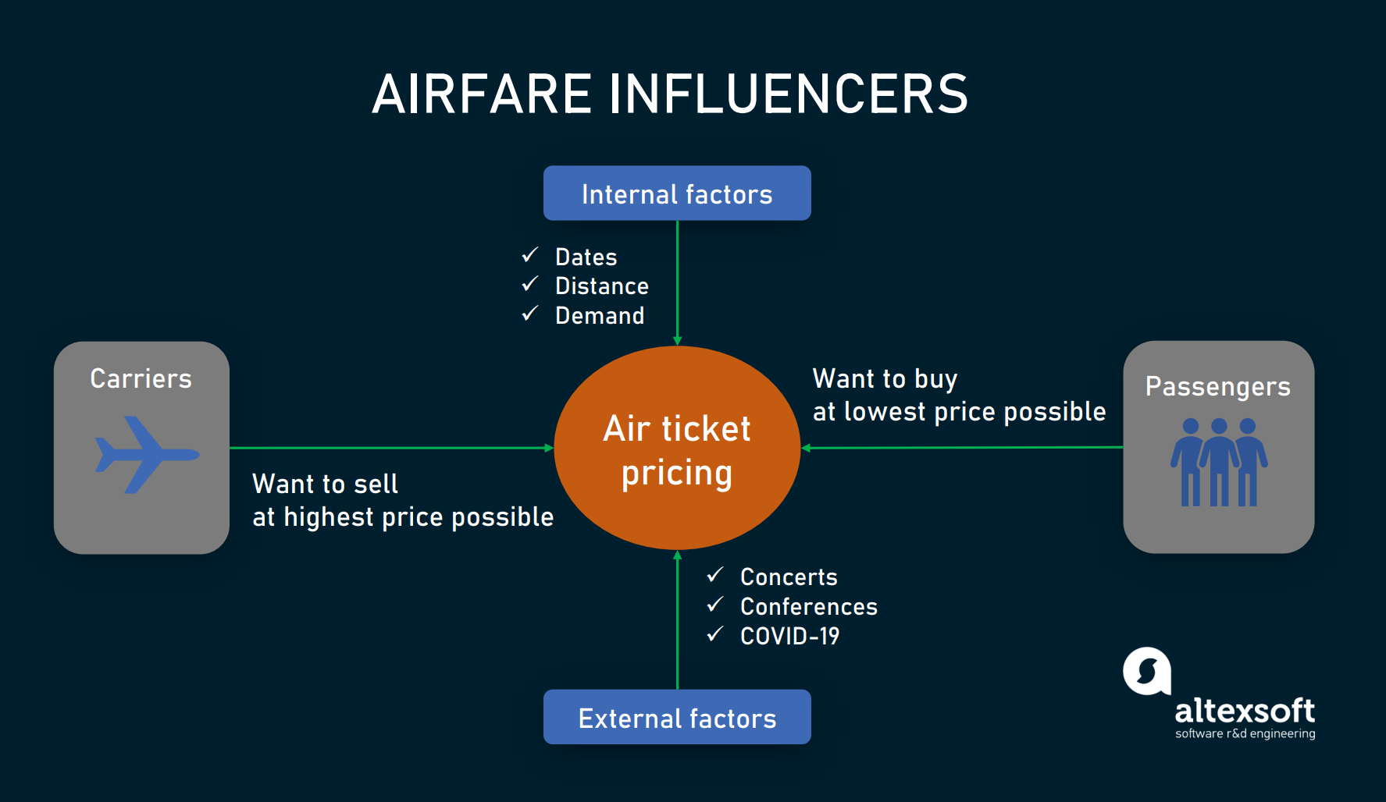
Benefits of Flight Price Prediction
Pricing in the airline industry is often compared to a brain game between carriers and passengers where each party pursues the best rates. Carriers love selling tickets at the highest price possible while still not losing consumers to competitors. Passengers are crazy about buying flights at the lowest cost available while not missing the chance to get on board. All this makes flight prices fluctuant and hard to predict. But nothing is impossible for people armed with intellect and algorithms. Predicting flight prices helps an individuals to know and understand the future price of the flight tickets.
There are two main use cases of flight price prediction in the travel industry. OTAs and other travel platforms integrate this feature to attract more visitors looking for the best rates. Airlines employ the technology to forecast rates of competitors and adjust their pricing strategies accordingly.
A passenger-side predictor proposed by an OTA suggests the best time to buy a ticket so that travelers can make informed decisions. Carriers, on their end, try to find out the optimal price they should set to maximize revenue while remaining competitive.

Slide 7
Data Analysis and Model Building Flowchart
Import Libraries
Import Collected Dataset
Data Preprocessing
Identifying Outliers and Skewness
(EDA) Visualizations
Feature Engineering
Label Encoder
Checking Correlation
Model Building
Saving the Model & Predictions
Hyper Parameter Tuning
R2 score & Evaluation Metrics

Slide 8
Exploratory Data Analysis (EDA) Steps
Importing necessary libraries and importing dataset as a data frame.
Checked some statistical information like shape, number of unique values present, info, data types etc.
Taking care of Timestamp variables by converting data types of “Departure_time” and “Time_of_arrival” from object data type into datetime data types.
Done feature engineering on some features as they had some irrelevant values and replaced them with empty spaces.
Extracted proper Duration column in terms of float data type from the difference of arrival time and departure time.Extracted Departure_Hour, Deparutre_Min and Arrival_Hour, Arrival_Min columns from Departure_time and Time_of_arrival columns and dropped these columns after extraction.
The label “Price" should be continuous numeric data but due to some string values like “,” it was showing as object data type. So, I replaced this sign by empty space and converted into float data type.
Grouped same categories in the column Meal_availability and converted categorical data into numeric data in Number_of_stops column.
Checked for null values and found no missing values in the dataset.
Performed univariate, bivariate and multivariate analysis. Visualized each feature using seaborn and matplotlib libraries by plotting several categorical and numerical plots like pie plot, count plot, bar plot, reg plot, strip plot, line plot, box plot, boxen plot, distribution plot, and pair plot.
Identified outliers using box plots and checked skewness and removed skewness in Duration column using sqrt method.
Used Pearson’s correlation coefficient to check the correlation between label and features. With the help of heatmap and correlation bar graph was able to understand the Feature vs Label relativity and insights on multicollinearity amongst the feature columns.

Slide 9
Visualization :Univariate Analysis for Numerical Variables
The distribution plot shows how the data has been distributed in each of the columns.
From the distribution plot we can observe the columns are somewhat distributed normally as they have no proper bell shape curve.
The columns like "Duration", "Number_of_stops" and "Price" are skewed to right as the mean value in these columns are much greater than the median(50%).
Also the data in the column Arrival_Hour skewed to left since the mean values is less than the median.
Since there is presence of skewness in the data, we need to remove skewness in the numerical columns to overcome with any kind of data biasness.

Slide 10
Univariate Analysis: Visualizing Counts of Categorical Variables
Airline: From the pie plot we can infer that there are more number of flights of "Air India", "Vistara" and "Indigo" compared to others. Also, the count of Alliance Air flights are very less.
Number_of_stops: From the above pie plot we can infer that 70.6% of the flights have only 1 stop during the journey and some of the flights (19.6%) have 2 stops where only few flights have 3 and 4 stops.
Meal_availability: Most of the flights providing free meals and few flights are not providing any meals.

Slide 11
Univariate Analysis: Visualizing Counts of Categorical Variables
Source: From the count plot we can observe more number of flights are from Mumbai, New Delhi, Hyderabad, Kolkata and Bangalore. Only few flights are from Hyderabad.
Destination: More number of flights are heading towards Mumbai, New Delhi and Bangalore. Only few flights are travelling to Lucknow.

Slide 12
Bivariate Analysis: Visualizing Categorical Variables vs Price
Airline vs Price: From the bar plot we can notice "Alliance Air" airlines have highest ticket price compared to other airlines.
Number_of_stops vs Price: From the strip plot we can notice the flights which have 1 and 2 stops between source and destination have highest ticket prices compared to others. The airlines which have 0 stops during the journey have very less ticket price.
Meal_availability vs Price: The boxplot shows the flights having Free meal facility have high ticket prices.

Slide 13
Bivariate Analysis: Visualizing Categorical Variables vs Price
Source vs Price: From the box plot we can observe the flights from Chennai are having somewhat higher prices compared to other sources.
Destination vs Price: From the boxen plot we can notice that the flights travelling to Goa and New Delhi have higher flight ticket prices.

Slide 14
Bivariate Analysis: Visualizing Numerical Variables vs Price
Departure_Hour vs Price: From the bar plot and line plot we can see that there are some flights departing in the early morning 1 AM having most expensive ticket prices compared to late morning flights. We can also observe the flight ticket prices are higher during afternoon (may fluctuate) and it decreases in the evening.
Departure_Min vs Price: The boxen plot and line plot gives there is no significant difference between price and departure min.

Slide 15
Bivariate Analysis: Visualizing Numerical Variables vs Price
Arrival_Hour vs Price: From the bar plot and line plot we can observe that very few flights are arriving in the early morning that is 0 to 6 AM they have very less ticket price. Also, the flights which are arriving in the afternoon and evening have somewhat higher price. So, we can conlude this column has some positive correlation with price.
Arrival_Min vs Price: There is no significant difference between this feature and price. We can say flight ticket prices are not much dependent on the Arrival_min.

Slide 16
Bivariate Analysis
Duration vs Price: From the reg plot we can observe some positive linear relation between Duration and Price. Flights having 1-12 hours of duration, they have ticket price of around 15000
Source vs Airline: The plot showing the region wise count of airlines which tells us that Kolkata source is having very few Alliance Air flights and it has Indigo flights in higher count compared to other sources. Other sources have Air India, Vistara, SpiceJet, Air Asia and Indigo flights with higher count.

Slide 17
Bivariate Analysis
Above plot gives the relation between Airline and Departure hour based on Number of stops. Air India and Air Asia flights are departing in the evening and they have less than 3 stops during the journey.
All the airlines provides free meals during the journey having the duration below 15 hours.

Slide 18
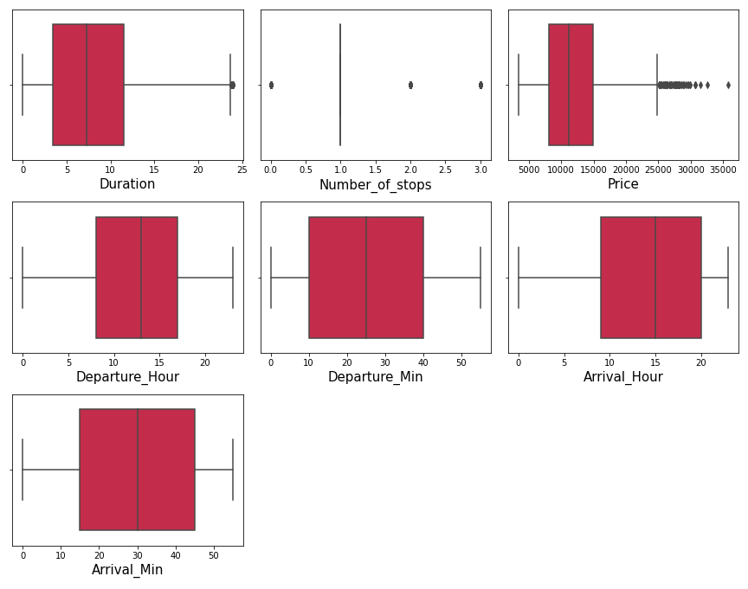
Identifying the outliers using box plot
A box plot is used to summarize data sets by using the box and whisker plot method. This function helps to understand the data summary properly. Box plots can be very useful when we want to know how the data is distributed and spread. Three types of quartiles are used in the box plot to plot the data. These values include the median, maximum, minimum, upper-quartile, and lower-quartile statistical values. A box plot summarizes this data in the 25th, 50th, and 75th percentiles.
From the box plot we can notice the outliers present in “Duration” ,“Number_of_stops” and "Price" columns.
Since Price is our target column and Number_of_stops is our categorical variable so no need to remove outliers in this columns. Finally there is no need to remove outliers in the dataset.

Slide 19
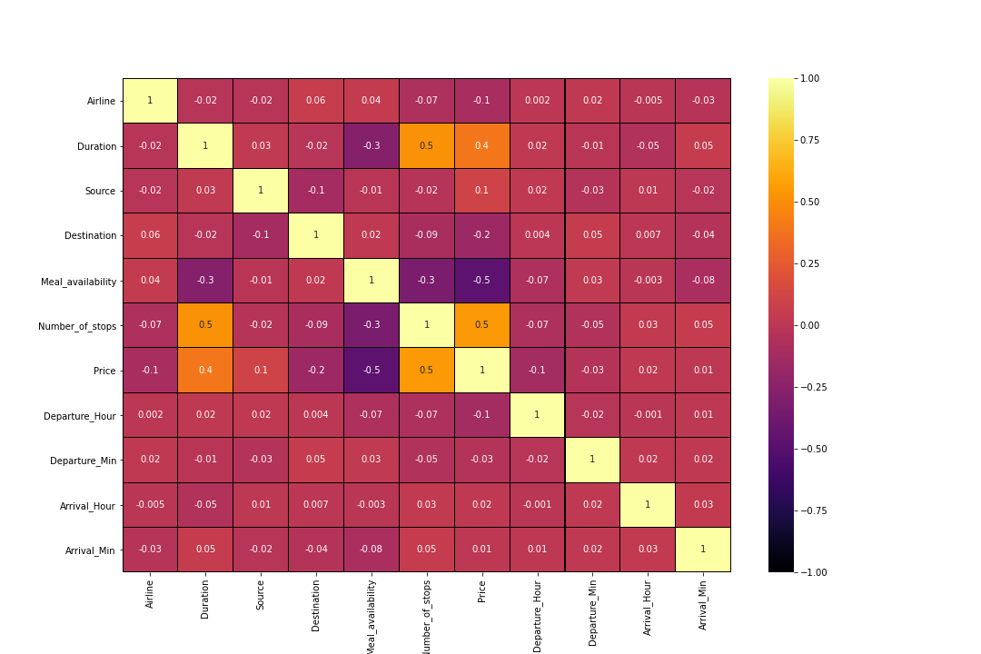
Correlation Between Features and Label
From the heat map and bar plot we can clearly observe the positive and negative correlation between the label and features. From the heat map we can notice that the light shades are highly positively correlated and dark shades are highly negatively correlated with the target variable.

Slide 20
Data Analysis Steps done
I have done feature engineering steps like feature extraction and feature selection to improve data normality and linearity.
Identified outliers using boxplots and found no outliers in numerical variables.
Identified skewness using distribution plots and removed skewness using square root transformation method.
Used Pearson’s correlation coefficient to check the correlation between dependent and independent variables. To visualize the correlation I have used heatmap and bar plot.
I have used StandardScalar method to scale the data to overcome with the issue of data biasness.
Split train and test to build machine learning models. Found best random state and best accuracy. Model building process will be shown in the further steps.

Slide 21
Assumptions:
Firstly, from the problem statement we got to know that it is a Regression type problem for which we used Regression algorithms to build the model and predicted the price of flight tickets by collecting the from yatra website using web scraping.
Secondly, from the distribution plots I found skewness in Duration column and from box plots I found outliers in target column and categorical column. Also, based upon the analysis and visualization part we have seen some of the features having somewhat linear relation with label. So, I assumed these features helps in model building and to predict price of the flight tickets. Also, this model helps the buyers to understand the future price of the flight tickets.
So, I suggest that the sellers and buyers take this model into consideration the features that were deemed as most important as seen in this study might help them estimate the flight ticket price.

Slide 22
Model Building:
In this problem “Price” is our target variable which is continuous in nature where we need to predict the price of flight tickets. From this I can conclude that it is a Regression type problem hence I have used following regression algorithms.
After the pre-processing and data cleaning I left with 11 columns including target and with the help of feature importance bar graph I used these independent features for model building and prediction. The algorithms used on training the data are as follows:
Decision Tree Regressor
Random Forest Regressor
Extra Trees Regressor
Gradient Boosting Regressor
Extreme Gradient Boosting Regressor (XGB)
Bagging Regressor
I have got the best random state and maximum R2 score and then created new train test split to build the above models.

Slide 23
Decision Tree Regressor
Created Decision Tree Regressor model and checked for its evaluation metrics. The model is giving R2 score as 17.83%.
From the graph we can observe how our model is mapping. In the graph we can observe the straight line which is our actual dataset and dots are the predictions that the model has given.

Slide 24
Random Forest Regressor:
Created Random Forest Regressor model and checked for it's evaluation metrics. The model is giving R2 score as 62.98%.
From the graph we can observe how our model is mapping. In the graph we can observe the straight line which is our actual dataset and dots are the predictions that our model has given.

Slide 25
Extra Trees Regressor:
We have created Extra Trees Regressor model and checked for its evaluation metrics. And the model is giving R2 score as 68.12%.
From the graph we can observe how our model is mapping. In the graph we can observe the straight line which is our actual dataset and dots are the predictions that our model has given.

Slide 26
Gradient Boosting Regressor:
Created Gradient Boosting Regressor model and checked for its evaluation metrics. The model is giving R2 score as 53.53%.
From the graph we can observe how our model is mapping. In the graph we can observe the straight line which is our actual dataset and the dots are the predictions that our model has given.

Slide 27
Extreme Gradient Boosting Regressor (XGB):
Created XGB Regressor model and checked for its evaluation metrics. The model is giving R2 score as 59.98%.
From the graph we can observe how our model is mapping. In the graph we can observe the straight line which is our actual dataset and the dots are the predictions that our model has given.

Slide 28
Bagging Regressor:
Created Bagging Regressor model and checked for its evaluation metrics. The model is giving R2 score as 58.95%.
From the graph we can observe how our model is mapping. In the graph we can observe the straight line which is our actual dataset and the dots are the predictions that our model has given.

Slide 29
Hyperparameter Tuning:
From the difference between R2 score and cross validation score we found “Extra Trees Regressor” having high R2 score compared to other models. So, we concluded that “Extra Trees Regressor” as our best fitting model. Performed Hyperparameter tuning to increase the best model accuracy.
I have used GridSearchCV to get the best parameters of Extra Trees Regressor. And used all the obtained best parameters to create the accuracy of final model.

Slide 30
Creating Final Model After Tuning:
I have successfully incorporated the hyper parameter tuning using best parameters of Extra Trees Regressor and the R2 score of the model has been increased after hyperparameter tuning and received the R2 score as 68.83% which is very good.
From the graph we can observe how our final model is mapping. In the graph we can observe the best fit line which is our actual dataset and the dots are the predictions that our best final model has given.

Slide 31
Saving The Final Model And Predictions From Saved Model
I have saved my final best model using joblib library in .pkl format, and loaded saved model for predictions.
Using regression model, we have got the predicted price of the flight tickets. From the above output we can observe that predicted values are almost near to the actual values.
The graph shows how our final model is mapping. The plot gives the linear relation between predicted and actual price of the used cars. The blue line is the best fitting line which gives the actual values/data and red dots gives the predicted values/data.

Slide 32
Conclusion:
The case study aims to give an idea of applying Machine Learning algorithms to predict the price of the flight tickets. After the completion of this project, we got an insight of how to collect data, pre-processing the data, analyze the data, cleaning the data and building a model.
First we collected the flights data from website yatra and it was done by using Web scraping. The framework used for web scraping was Selenium, which has an advantage of automating our process of collecting data. We collected almost 3664 of data which contained the ticket price of the flights and other related features. Then, the scrapped data was saved in a excel file so that we can use further and analyze the data.
Then we loaded the dataset and have done data cleaning, EDA process and pre-processing techniques like checking outliers, skewness, correlation, scaling data etc. And got better insights from data visualization.
From the visualizations we got to know that flight ticket prices change during morning and evening time of the day. From the distribution plots we came to know that the prices of the flight tickets are going up and down, they are not fixed at a time. Also, from this graph we found prices are increasing in large amounts. Also from categorical and numerical plots we found that the prices are tending to go up as the time is approaching from morning to evening. From the categorical plots (bar and box) we came to know that early morning and late night flights are cheaper compared to working hours. From the categorical plots we found that the flight ticket prices increases as the person get near to departure time. That is last minute flights are very expensive. From the bar plot we got to know that both Indigo and Spicejet airways almost having same ticket fares.
After separating our train and test data, we started running different ML regression algorithms to find out the best performing model on the basis of different metrics like R2 Score MAE, MSE, RMSE. We got Extra Trees Regressor as the best model among all the models. On this basis we performed the Hyperparameter tuning to find out the best parameter and improving the scores. The R2 score increased after tuning so, we concluded that Extra Trees Regressor as the best model as it was giving high R2 score after tuning.

Slide 33
Thank You

